Slide 1

Batho Ba Rona Supermarket
Network Design
BBR
CMPG 325 Computer Networks Project
Project ID CMPG325-2026-015 | Client ID CLI-015
Addressing Block: 192.168.17.0/24
Presented by : Dimba Sinenhlanhla
Student number : 42279682

Slide 2
Client and requirements
1
Addressing block 192.168.17.0/24
The client
Assigned by the brief
Retail supermarket in Mahikeng serving the local community
Runs on POS transactions, admin staff and staff Wi-Fi
One part-time IT support person manages everything
2
Segment by department
POS, Admin, Wi-Fi/Staff, Server
3
Simple, one-person routing
Static default route to the ISP
4
CR5: users grow by 25%
No renumbering allowed

Slide 3
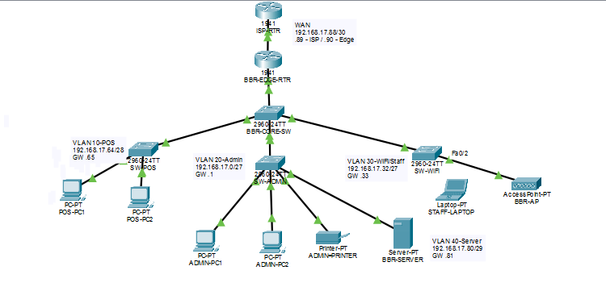
Network topology

Slide 4
IP addressing plan (VLSM)
VLAN | Subnet | Mask | Hosts | Host range
20 Admin | 192.168.17.0/27 | 255.255.255.224 | 30 | .1 – .30 (GW .1)
30 Wi-Fi/Staff | 192.168.17.32/27 | 255.255.255.224 | 30 | .33 – .62 (GW .33)
10 POS | 192.168.17.64/28 | 255.255.255.240 | 14 | .65 – .78 (GW .65)
40 Server | 192.168.17.80/29 | 255.255.255.248 | 6 | .81 – .86 (GW .81)
WAN Edge-ISP | 192.168.17.88/30 | 255.255.255.252 | 2 | .89 – .90
One /24 block divided with VLSM; the four VLAN subnets are sized for growth, so unused space remains.

Slide 5
Built-in growth capacity (CR5)
POS
Admin
Wi-Fi/Staff
Server
16
30
30
6
planned capacity
planned capacity
planned capacity
planned capacity
10 today, 13 at +25%
15 today, 19 at +25%
20 today, 25 at +25%
3 today, 4 at +25%
New devices simply join existing VLANs. No re-addressing or renumbering is needed.

Slide 6
Why a static default route
Single ISP connection
1
0.0.0.0/0
All traffic not for the internal VLANs can use one next hop.
Simple to maintain
Any traffic not destined for a local subnet is forwarded to the ISP router at 192.168.17.89.
2
Suits the client's one part-time IT support person; no routing protocol to manage.
Small, fixed design
3
Four VLANs that are easy to document and support.
Route type: S*

Slide 7
Default route configuration
BBR-EDGE-RTR
interface GigabitEthernet0/1
ip address 192.168.17.90 255.255.255.252
ip route 0.0.0.0 0.0.0.0 192.168.17.89
ISP-RTR
interface GigabitEthernet0/0
ip address 192.168.17.89 255.255.255.252
ip route 192.168.17.0 255.255.255.0 192.168.17.90

Slide 8
Connectivity verified
✓
Edge router to ISP
✓
POS-PC1 (VLAN 10)
Ping 5/5 (100%) to 192.168.17.89; traceroute reaches it in 1 hop.
0% loss to gateway .65; 2 hops to the ISP via .65.
✓
ADMIN-PC1 (VLAN 20)
✓
STAFF-LAPTOP (VLAN 30)
0% loss to the ISP; 2 hops via Admin gateway .1.
0% loss to the ISP via BBR-AP; 2 hops via gateway .33.

Slide 9
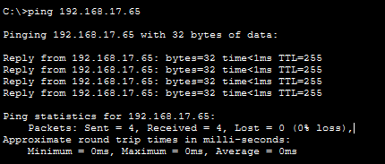
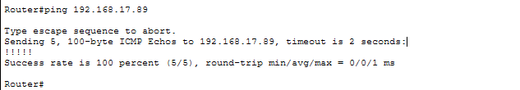
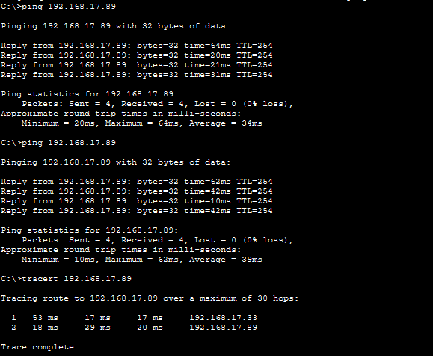
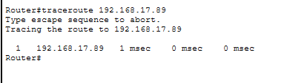
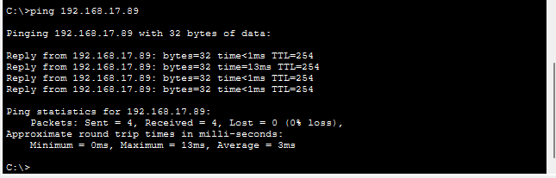
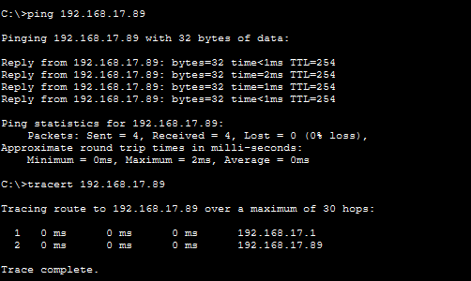
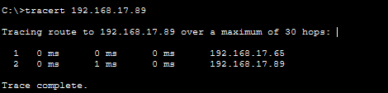
Connectivity verified: evidence
POS-PC1 (VLAN 10)
Edge router to ISP
STAFF-LAPTOP (VLAN 30)
ADMIN-PC1 (VLAN 20)
All paths reach the ISP router (192.168.17.89) with 0% packet loss.

Slide 10
Troubleshooting
1
POS switch disconnected
2
ISP router not configured
Cable between SW-POS and the core was lost. Found with show interfaces status; reconnected Fa0/1 to Fa0/2.
Pings failed until its interface and return route to 192.168.17.0/24 were added.
3
First-ping timeouts
4
Wi-Fi VLAN unreachable
ARP was still resolving the neighbour's MAC. Repeating the ping gave 100%.
Core port Fa0/4 was an access port in VLAN 1. Reconfigured as a trunk allowing VLAN 30.

Slide 11
Conclusion
I built a network for Batho Ba Rona Supermarket in Cisco Packet Tracer.
The 192.168.17.0/24 block was split into four VLANs (POS, Admin, Wi-Fi/Staff and Server) plus a WAN link to the ISP.
One static default route on the edge router (to 192.168.17.89) suits the shop’s single ISP connection and its one part-time IT person. Ping and traceroute confirmed that the POS, Admin and Wi-Fi/Staff VLANs all reach the ISP.
I fixed three faults along the way: a disconnected cable, a missing ISP return route and a trunk port without VLAN 30. The subnets also leave room for the 25% user growth without renumbering.
THANK YOU

